Slide 1
Oncology
Introduction

Slide 2
Definitions
Oncology – The study and treatment of tumors
A branch of medicine that deals with the prevention, diagnosis and treatment of cancer.
Tumors – An abnormal mass of tissue that forms when cells grow and divide more than they should or do not die when they should. (Apoptosis)

Slide 3
Definitions
Tumors may be benign or malignant (cancer)
Benign Tumors can grow large but do not spread into or invade nearby tissues or other parts of the body.
Cancer – a malignant growth or tumor resulting from an uncontrolled division of cells. They have the potential to invade or spread to other parts of the body.

Slide 4
Definitions
Oncogenesis – the process through which healthy cells become transformed into cancer cells. It is characterized by a series of genetic and cellular changes, including oncogene activation, that lead the cell to divide in an uncontrolled manner.
Oncogene – a gene that has the potential to cause cancer. In cancer cells, these genes are often mutated or expressed in high levels.

Slide 5
Oncogenes
Proto-oncogenes - are cellular genes that are important for normal cellular function and code for various proteins, including transcriptional factors, growth factors, and growth factor receptors.
These proteins are vital components in the network of signal transduction that regulate cell growth, division, and differentiation.
Proto-oncogenes can be altered to form oncogenes, genes that when translated can result in the malignant transformation of a cell.
The three main mechanisms by which proto-oncogenes can be activated include:
Amplification
Point mutations
Translocation

Slide 6
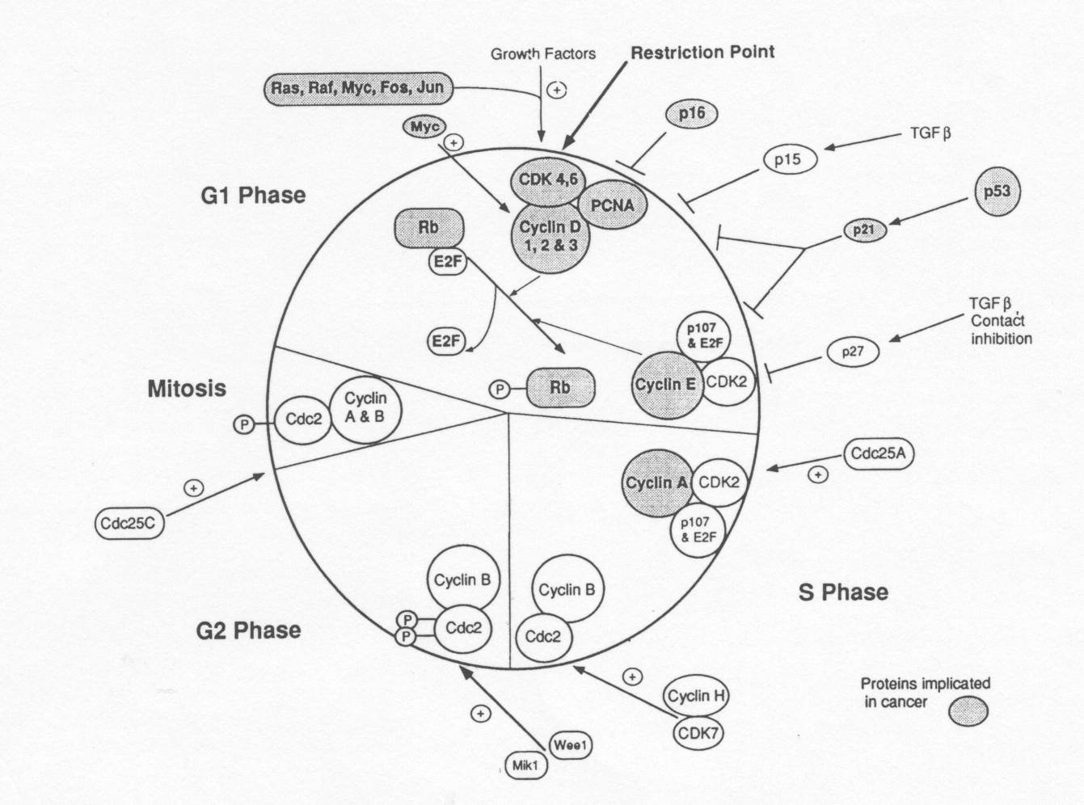
Cell Cycle Regulators and Cancer

Slide 7
Common properties of cancer cells
The most aggressive cancer cells display all of these features.
Alterations are caused by mutations that affect growth factor receptors and signal transduction genes, cell cycle regulatory genes, DNA repair genes, or genes controlling apoptosis.
Depending on whether the affected gene normally stimulates or inhibits proliferation, the mutated gene is called an oncogene or a tumor-suppressor gene.

Slide 8
Common properties of cancer cells
Cancers typically originate in dividing cells, such as precursor (progenitor) stem cells that give rise to differentiated tissues in the adult.
Most cancers originate in somatic cells and not germ-line cells.
Microscopically, cancer cells show abnormal location and morphology, loss of structural features characteristic of a differentiated cell, and an abnormally large nucleus and prominent nucleoli.
The cytoskeleton typically also is abnormal.
Karyotyping may show gross chromosomal abnormalities

Slide 9
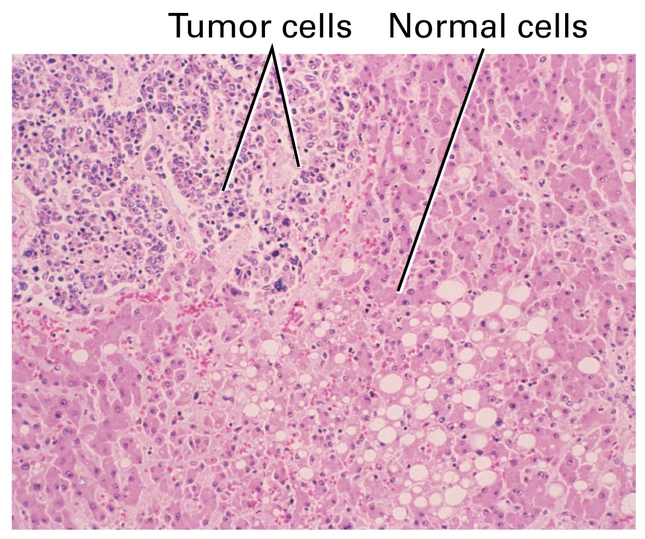

Slide 10
Common properties of cancer cells
Most malignant tumor cells eventually acquire the ability to metastasize. To do so they must degrade the basement membranes of connective tissue underlying epithelial cells and surrounding the endothelial cells of blood vessels.
This can be accomplished by secretion of plasminogen activator, which activates the blood protease, plasmin.

Slide 11
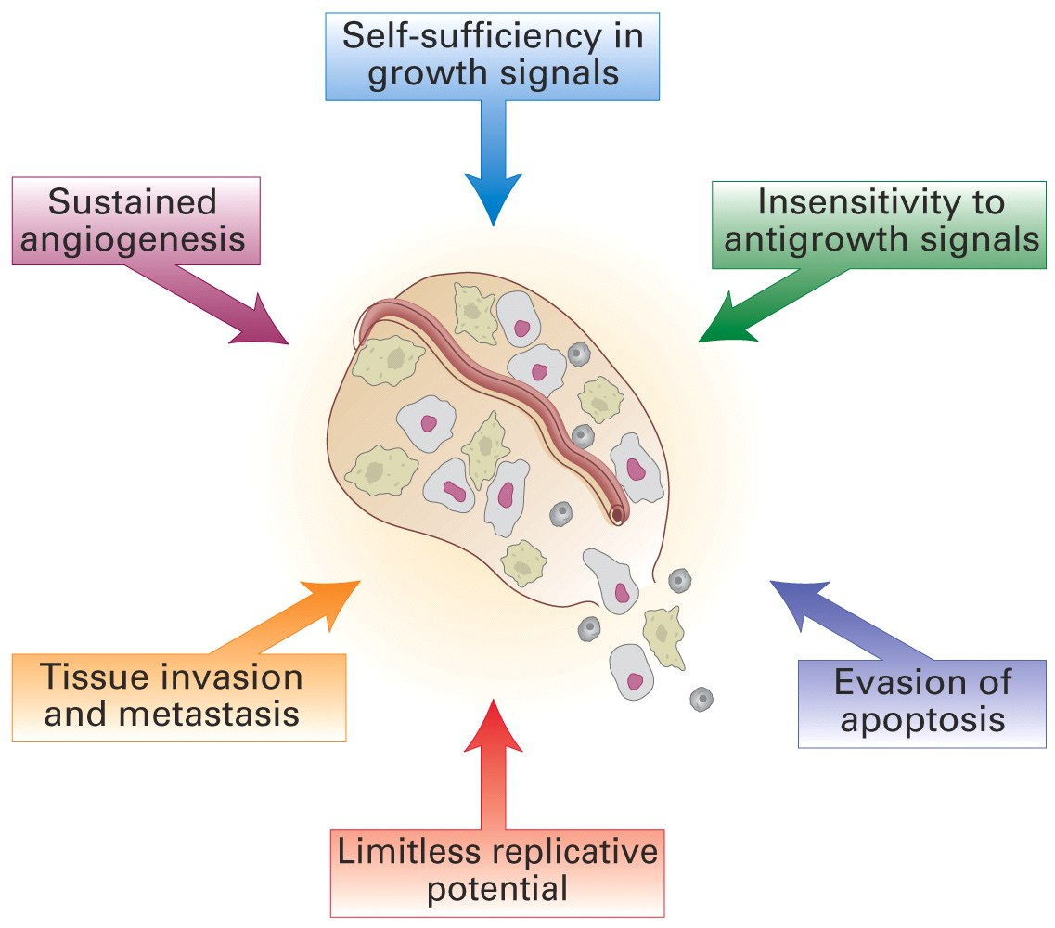
Common properties of cancer cells

Slide 12
Genes Commonly Mutated in Cancer
Genes that control cell growth and proliferation are commonly mutated in cancers . Gain-of-function mutations that increase the activity of proto-oncogenes such as growth-promoting signaling molecules (I), receptors (II), intracellular signal transduction pathways (III), or TFs (IV) are associated with cancers.
The resulting mutated genes are referred to as oncogenes.
Gain-of-function mutations in anti-apoptotic genes.
Loss-of-function mutations in tumor-suppressor genes such as cell cycle control proteins (V), DNA repair proteins (e.g., caretaker genes, VI), or anti-proliferative factor receptors such as the TGFß receptor can cause cancer.
Loss-of-function mutations in pro-apoptotic genes are associated with cancer

Slide 13
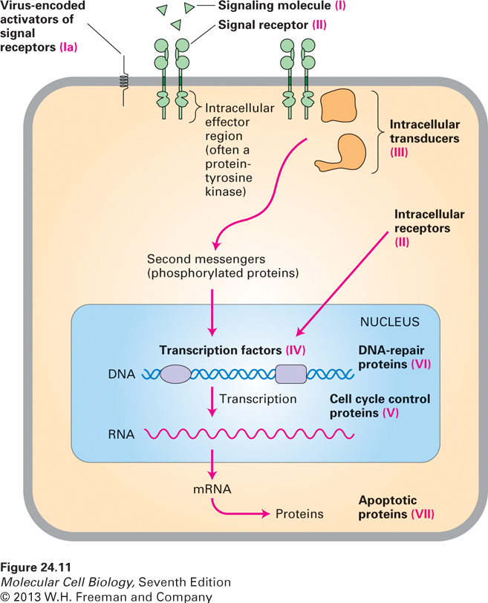

Slide 14
Genes Commonly Mutated in Cancer
Although relatively rare, human cancers can be caused by retroviruses that carry dominant viral oncogenes.
More commonly, the insertion of a strong retroviral promoter upstream of a proto-oncogene can switch it on leading to cancer.

Slide 15
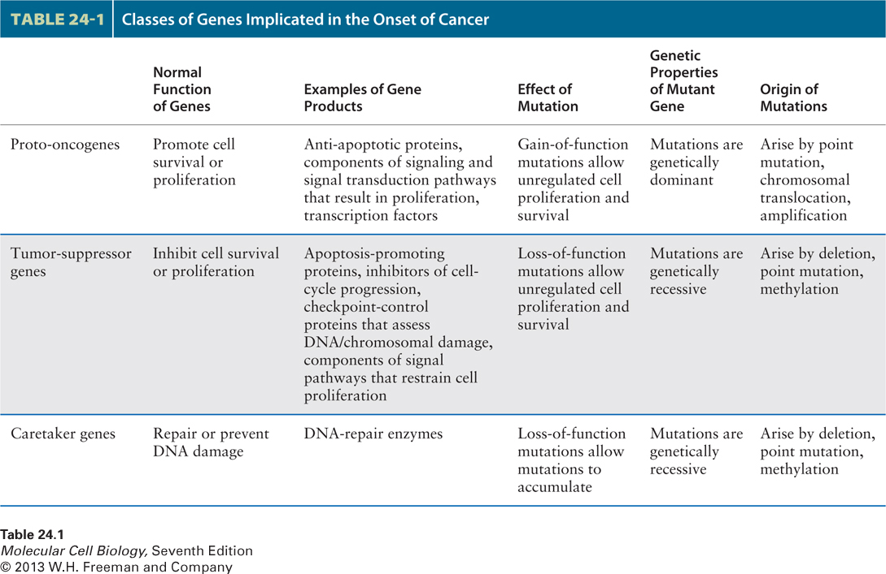

Slide 16
Risk factors for childhood cancers

Slide 17
Risk factors
Acute lymphoblastic leukemia
Ionizing radiation, therapeutic radiation
Race – whites x2 more than blacks
Genetic conditions
- Down syndrome -10- to 20-fold increased risk.
Neurofibromatosis type 1
Bloom's syndrome
Ataxia-telangiectasia, and
Langerhans cell histiocytosis

Slide 18
Risk factors
Acute myeloid leukemia
Chemotherapeutic agents - Alkylating agents
Epipodophyllotoxins
Genetic conditions - Down syndrome and neurofibromatosis type 1, Familial monosomy 7
Brain cancers
Therapeutic ionizing radiation to the head With the exception of cancer radiotherapy
Genetic conditions - Neurofibromatosis type 1 (optic gliomas), Tuberous sclerosis

Slide 19
Risk factors
Hodgkin disease and Non-Hodgkin lymphoma
Family history
Monozygotic twins and siblings of cases are at increased risk.
Infections - Epstein-Barr virus (Burkitt’s lymphoma)
- Immunodeficiency - Acquired and congenital immunodeficiency disorders, immunosuppressive therapy.

Slide 20
Risk factors
Osteosarcoma
Ionizing radiation
Cancer radiotherapy and high radium exposure.
Chemotherapy - Alkylating agents
Genetic conditions - Li-Fraumeni syndrome and hereditary retinoblastoma.

Slide 21
Risk factors
Malignant germ cell tumors – Cryptorchidism (testicular germ cell tumors).
Wilms tumor
Congenital anomalies - Aniridia, Beckwith-Wiedemann syndrome,
Race - Asian children reportedly have about half the rates of white and black children.
Others - maternal diethylstilbestrol intake during pregnancy and subsequent vaginal cancer in adolescent female.
Unconvincing - pesticides, parental occupational chemical exposures, dietary factors, and environmental cigarette smoke.

